Slide 1

Heart disease prediction using machine learning A random forest approach with feature Importance Analysis

Slide 2
Heart Disease Prediction using Machine Learning AKULA POOJA 2301600053 GUIDED BY B KRISHNA

Slide 3

Agenda
ABSTRACT
PROBLEM STATEMENT
INTRODUCTION
SOFTWARE AND HARDWARE REQUIREMENTS
BASE PAPER
LITERATURE SURVEY
UML DIGRAMS
SYSTEM DESIGN
ALGORITHMS USE
TECHINAL STACK
CODE EXPLANATION
PARCIAL IMPLEMENTATION
RESULT
FEATURE SCOPE
CONCLUSION
`6+3
UML

Slide 4
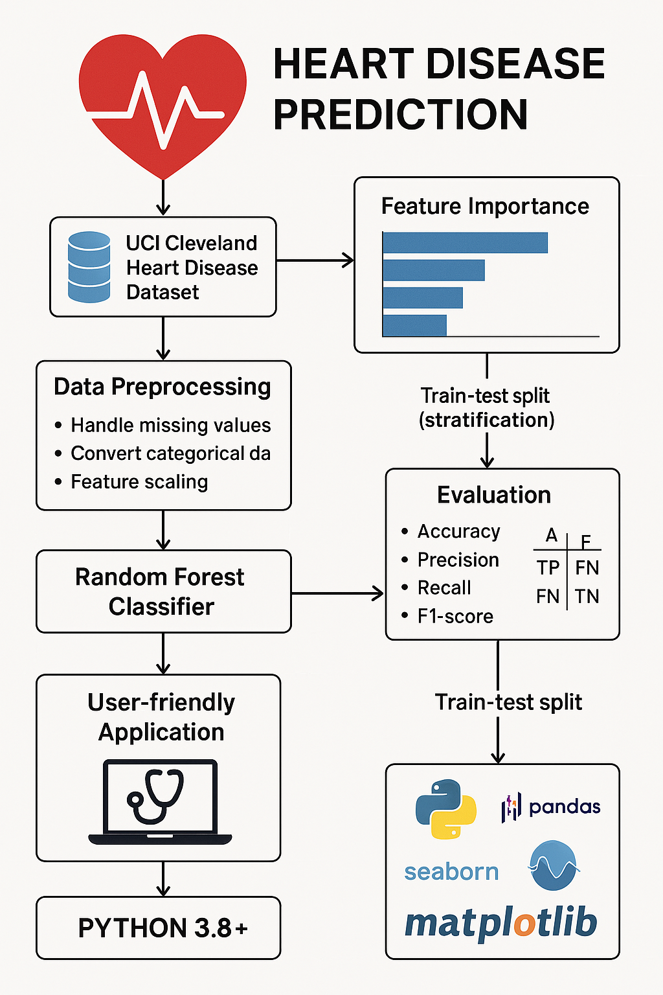
This project leverages machine learning to predict heart disease for early diagnosis and intervention. Using the UCI Cleveland Heart Disease dataset, essential clinical features are preprocessed and analyzed. A Random Forest Classifier is trained with stratified data splitting to ensure balanced predictions. Feature importance analysis highlights key risk factors influencing heart health. Evaluation metrics like accuracy, recall, and confusion matrix validate model performance. The model is deployed in a user-friendly Python-based application, aiding healthcare professionals in real-time assessment.

Slide 5

INTRODUCTON:- This project presents a machine learning-based approach to predict heart disease using clinical data. The UCI Cleveland dataset is processed and analyzed to extract meaningful health indicators. A Random Forest Classifier is chosen for its accuracy and ability to handle complex data. Feature importance analysis helps identify key factors contributing to heart disease risk. Model performance is evaluated using accuracy, precision, recall, F1-score, and confusion matrix. The final system is deployed as a user-friendly application for real-time medical risk assessment.

Slide 6
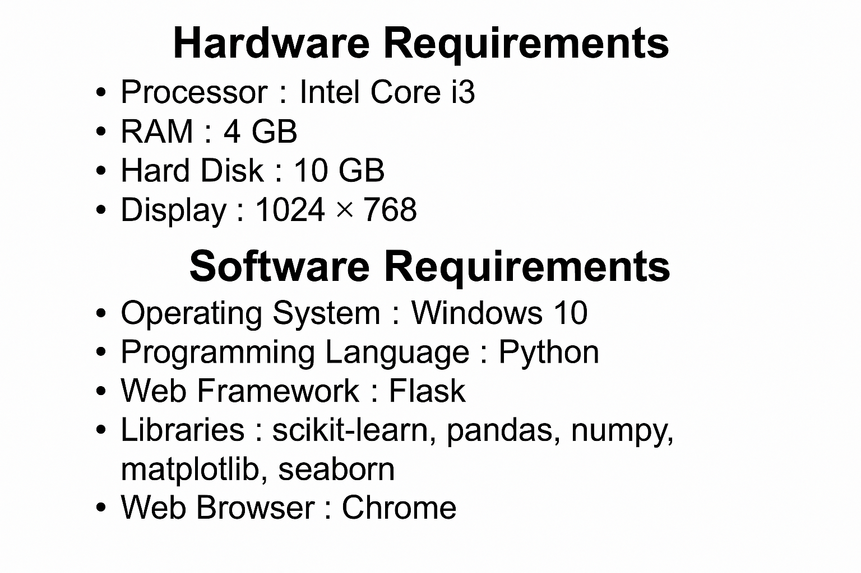
Processor: Minimum Intel Core i3 or above for running Flask server and model training without lag.
RAM: At least 4 GB recommended for model loading and testing the web application.
Storage: A minimum of 500 MB free space is needed for libraries, datasets, and project files.
Display: Standard monitor/screen (1024x768 resolution or higher) for GUI display and result analysis.
Keyboard & Mouse: Required for user input, especially during testing and interaction with the web interface.

Slide 7
💻 Software Requirements
Operating System: Windows 10/11 or Linux (Ubuntu) – both compatible with Python and Flask.
Python (3.8+): Core programming language used for data analysis, model building, and backend.
Flask: Used to build the lightweight web application for prediction interface.
Jupyter Notebook/VS Code: IDEs used for code development, model training, and testing.
Libraries:
pandas, numpy for data preprocessing.
sklearn for machine learning model (Random Forest or Logistic Regression).
matplotlib, seaborn for visualizations.
Web Browser: Chrome/Firefox for running and testing the Flask web application locally.

Slide 8
Base paper
The paper compares Naïve Bayes and Random Forest classifiers for heart disease prediction.
The dataset used was obtained from the UCI Machine Learning Repository.
Preprocessing techniques like data normalization and cleaning were applied to improve model accuracy.
Random Forest outperformed Naïve Bayes in terms of accuracy and prediction capability.
Evaluation metrics such as accuracy, precision, recall, and F1-score were used.
Rashmi, M., & Vikram, K., "Prediction of Heart Disease using Machine Learning Algorithms – Naïve Bayes and Random Forest", in Proceedings of the International Conference on Smart Electronics and Communication (ICOSEC), 2020, pp. 1271–1276. 📄 IEEE Link: https://ieeexplore.ieee.org/document/9215333

Slide 9
Literature survey
Author(s) | Title of the Paper | Year | Techniques Used
Palaniappan, S. & Awang, R. | Intelligent Heart Disease Prediction System using Data Mining Techniques | 2008 | Decision Tree, Naïve Bayes
Zekic-Susac, M. et al. | Comparative Analysis of Machine Learning Models in the Prediction of Heart Disease | 2014 | SVM, Neural Networks
Rashmi, M. & Vikram, K. | Prediction of Heart Disease using Machine Learning Algorithms – Naïve Bayes and Random Forest | 2020 | Naïve Bayes, Random Forest
Gudadhe, M. et al. | Decision Support System for Heart Disease based on SVM and ANN | 2010 | SVM, Artificial Neural Networks

Slide 10

UML DIAGRAMS
A "random forest" in machine learning is an ensemble learning method that combines multiple decision trees, each trained on a random subset of the data, to make predictions, resulting in a more robust and accurate model compared to a single decision tree.
In machine learning, "feature importance analysis" refers to a technique used to determine how much each individual feature in a dataset contributes to the predictive power of a mode

Slide 11
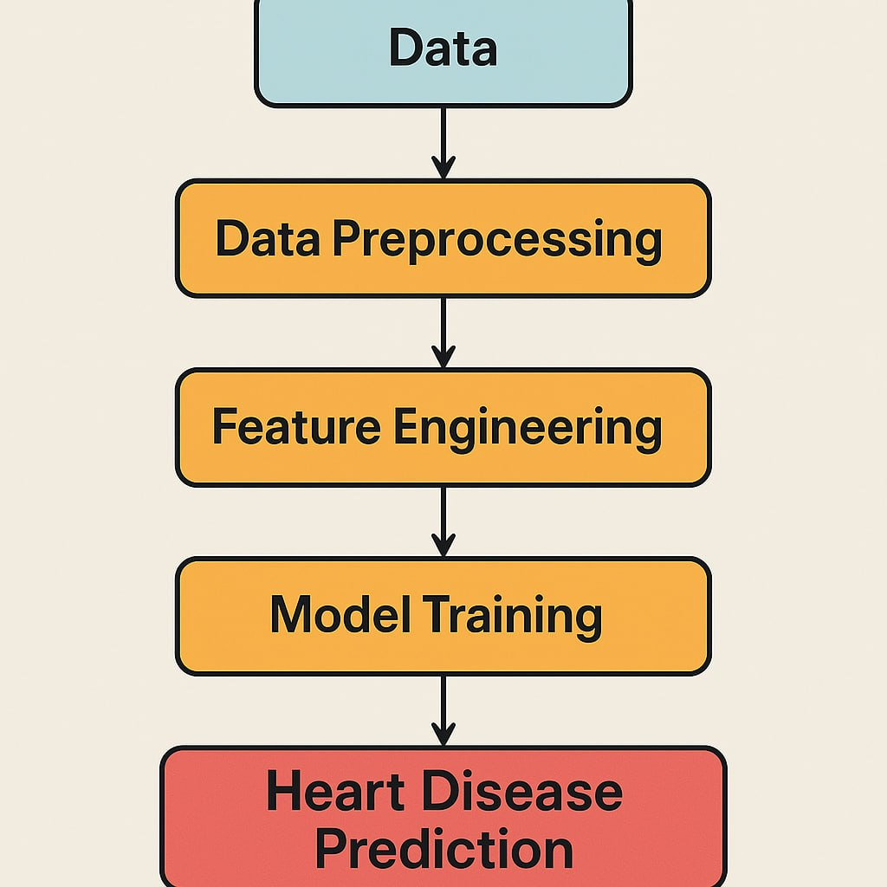
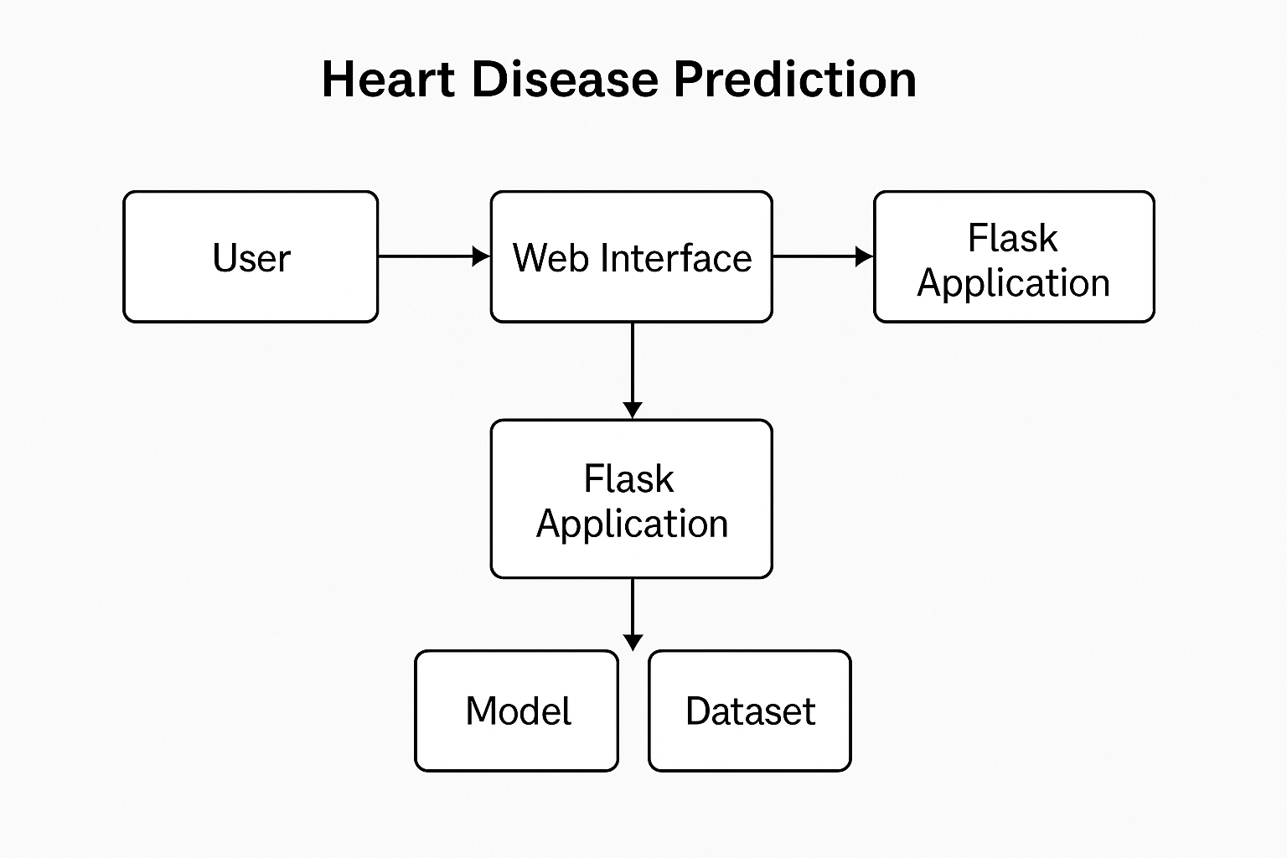
SOFTWARE DESIGN
The architecture of the Heart Disease Prediction system is structured into four main layers: User Interface, Flask Backend, Machine Learning Model, and Database/Storage.
The user interacts with a web-based frontend developed using HTML, CSS, and JavaScript to input medical parameters.
These inputs are sent to the Flask backend, which acts as the controller, managing requests and responses.

Slide 12
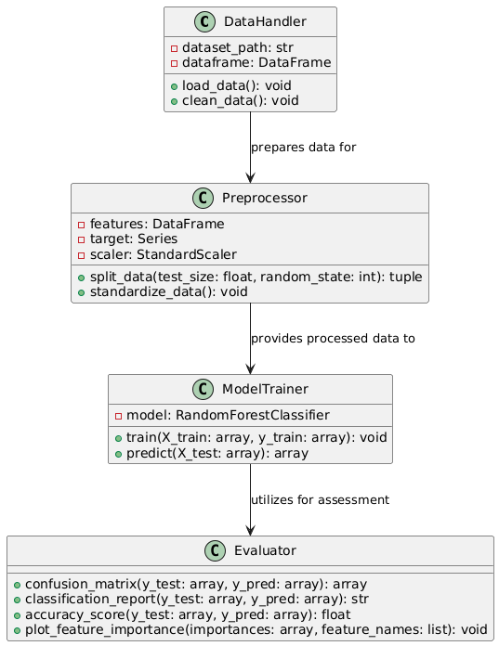
CLASS DIAGRAM
Class Diagram represents the structure of the system by showing its classes, attributes, and methods. In this project, classes like User, HeartData, and PredictionModel are central to the application. Each class contains specific attributes — for example, HeartData holds patient details like age, BP, cholesterol, etc. Methods within the PredictionModel class are responsible for training and predicting heart disease using machine learning. The relationships between these classes demonstrate how data flows through the system. This diagram helps in understanding the object-oriented structure of the prediction system.

Slide 13
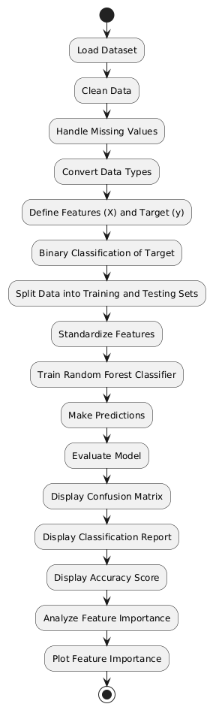
ACTIVITY DIAGRAM
The Activity Diagram outlines the dynamic flow of activities involved in predicting heart disease. It begins with the user inputting medical data such as age, blood pressure, cholesterol, etc. The system then validates the input and processes it for prediction using a trained machine learning model. Based on the prediction result, the system provides feedback — indicating whether the patient is likely to have heart disease. This diagram clearly visualizes the step-by-step flow of actions and decision points. It helps in understanding how the system responds to different user actions in real-time.

Slide 14
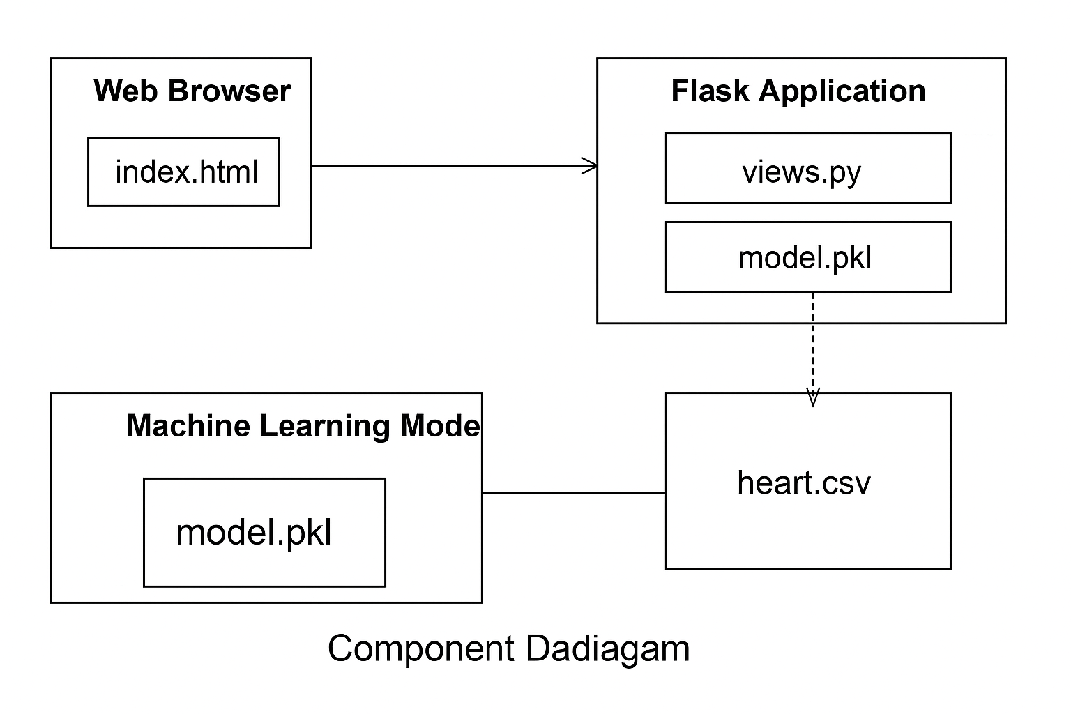
Component Diagram This diagram represents the architecture of a web-based heart disease prediction application using Flask and machine learning. The flow starts with the Web Browser, where the user interacts with the index.html page. This sends requests to the Flask Application, which contains the core logic in the views.py file and the trained model.pkl file. The Flask app processes inputs and invokes the machine learning model to make predictions. The model uses the model.pkl file, which contains the trained model's parameters. The machine learning model also interacts with a heart.csv file, likely used for data handling or training. Overall, this diagram depicts the integration of the user interface (index.html), backend (Flask), and the machine learning model to predict heart disease outcomes.

Slide 15
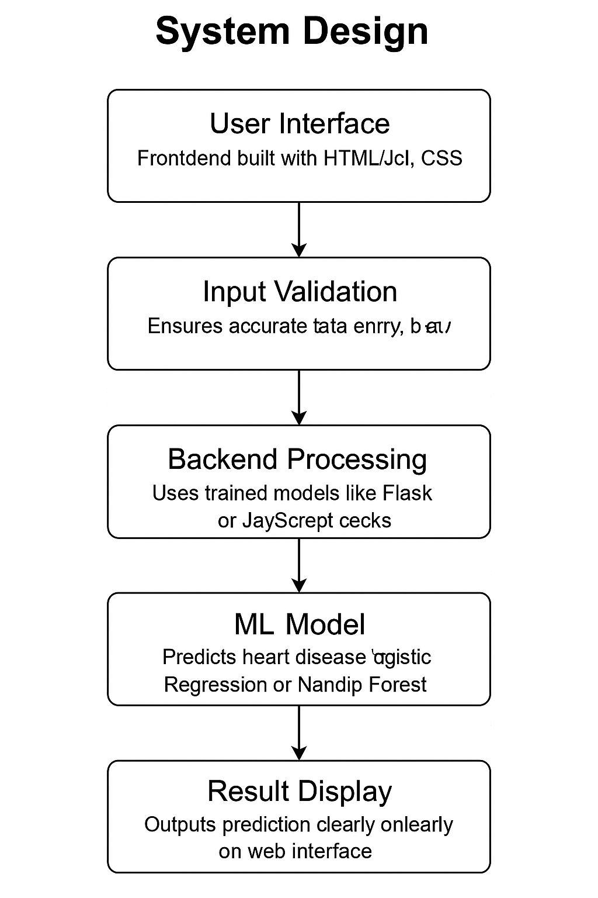
System design
User Interface: Frontend built with HTML/CSS for collecting user health inputs.
Input Validation: Ensures accurate data entry using Flask or JavaScript checks.
Backend Processing: Flask backend processes inputs and communicates with the ML model.
ML Model: Predicts heart disease using trained models like Logistic Regression or Random Forest.
Result Display: Outputs prediction clearly on the web interface for user interpretation.

Slide 16
ALGORITHM USED
Data Collection: UCI Heart Disease dataset is used, containing medical attributes like age, cholesterol, blood pressure, etc.
Data Preprocessing: The dataset is cleaned, scaled using StandardScaler, and split into training and testing sets.
Model Selection: Logistic Regression (or Random Forest) is used for classification to predict heart disease presence.
Model Training: The model is trained using the training data to learn patterns from patient health attributes.
Prediction & Evaluation: The trained model predicts disease risk on test or user input, evaluated using accuracy and confusion matrix.
Web Integration: A Flask web app is developed where users input values via a form, and the model gives prediction results on the browser

Slide 17
Technical stack
Python: The core programming language used for implementing the machine learning model (Logistic Regression or Random Forest) and backend logic.
Flask: A lightweight Python web framework used to build and deploy the backend server that handles HTTP requests and responses for your prediction model.
Machine Learning Algorithms: Logistic Regression or Random Forest algorithms used for training and predicting heart disease based on input data.
HTML/CSS/JavaScript: Frontend technologies used to design the user interface (UI) of the web application for user interaction and display results.
Jinja2 (Flask template engine): Used in Flask to render HTML templates dynamically and pass data from the backend (Python) to the frontend for real-time updates.

Slide 18
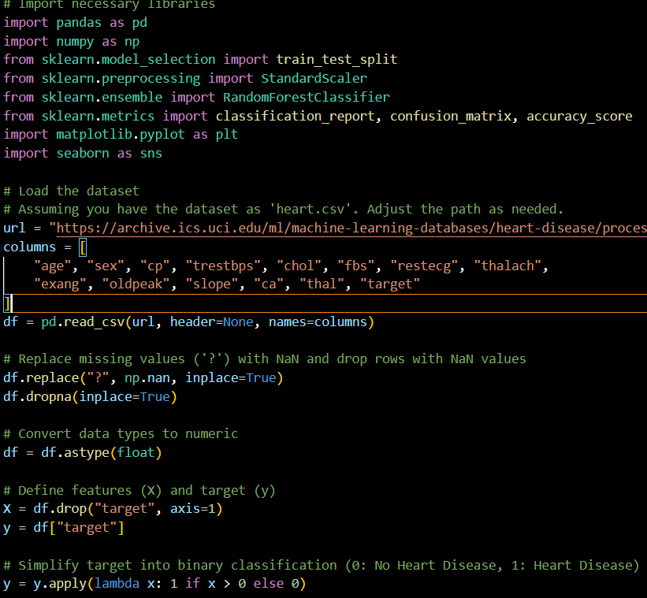
CODE EXPLANATION

Slide 19
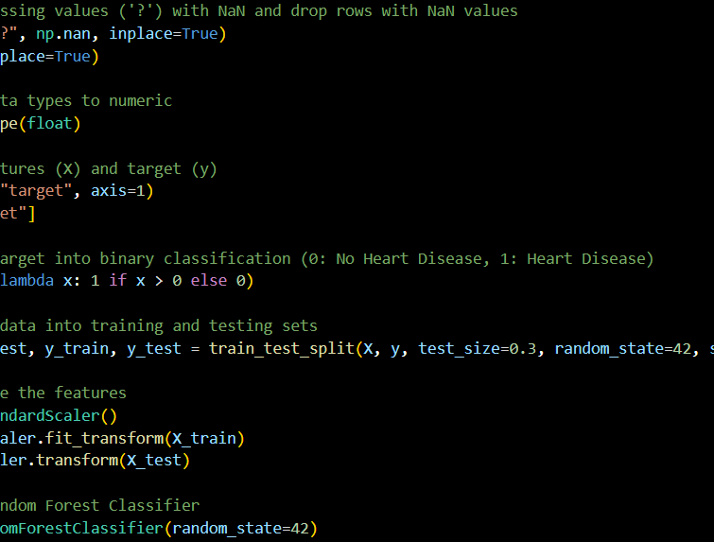

Slide 20
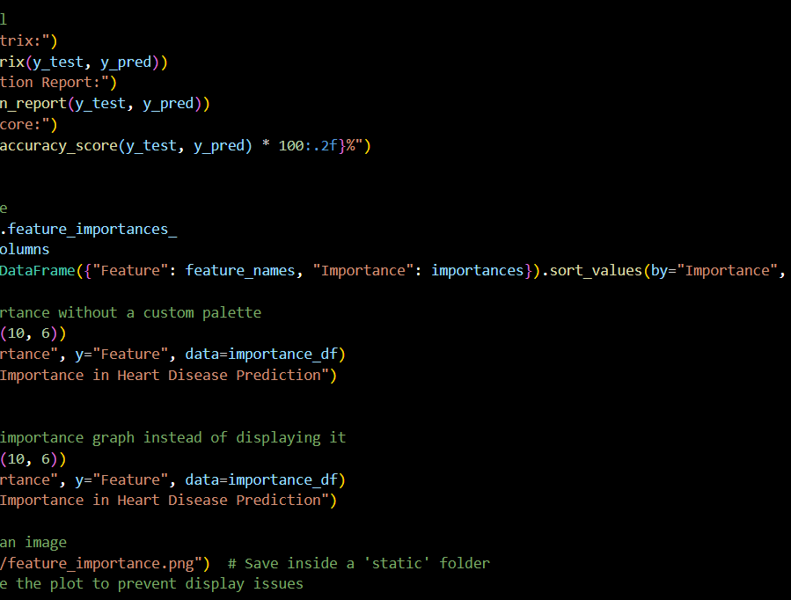

Slide 21
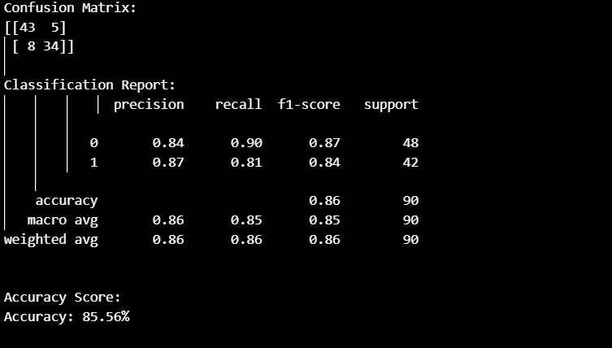
PARCIAL IMPLEMENTATION

Slide 22
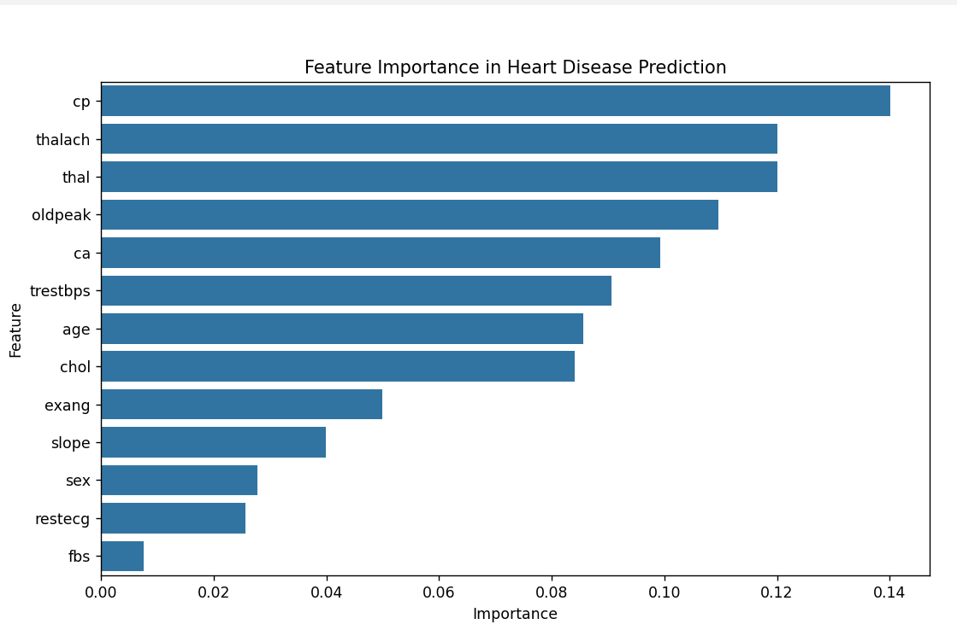
REASULT ANALYSIS

Slide 23
Feature scope
Real-Time Monitoring Integration:
Future versions can integrate real-time health data from wearable devices (e.g., smartwatches, fitness bands) to make predictions more dynamic and accurate.
Advanced Machine Learning Models:
Incorporating deep learning techniques like neural networks or ensemble models could improve prediction accuracy and handle larger, more complex datasets.
Mobile App Development:
Creating a mobile application can make the system accessible to users anytime, anywhere, increasing its usability and impact.
Electronic Health Record (EHR) Integration:
Linking with hospital databases and EHR systems can automate the prediction process and assist doctors in real-time clinical decision-making.
User Personalization:
Future versions can offer personalized health recommendations and early warning alerts based on individual risk profiles.
Data Privacy and Security Enhancements:
Implementing stronger data encryption and privacy-preserving techniques like federated learning can make the system more secure and trustworthy for users.

Slide 24
conclusion
The Heart Disease Prediction System developed in this project demonstrates how technology and healthcare can come together to create powerful, life-saving tools. By leveraging machine learning algorithms on historical health data, this system offers a smart, efficient, and cost-effective solution to predict the risk of heart disease in individuals.
The model not only enhances early diagnosis but also empowers both healthcare professionals and patients to make informed decisions. With growing cases of cardiovascular diseases worldwide, tools like these can significantly contribute to preventive care and reduced mortality rates.
Our system stands as a foundation, showing how data-driven models can revolutionize the healthcare domain. While this project uses fundamental machine learning approaches, it opens doors for future integration of real-time health monitoring, personalized recommendations, and advanced AI algorithms.
In addition, the simplicity of the user interface ensures usability even for non-technical users, making this solution practical in real-world scenarios, especially in rural and resource-constrained areas.
In essence, this project is more than just a prediction model—it’s a vision of how intelligent systems can assist humanity in leading longer, healthier lives. As technology continues to evolve, so too will the scope and impact of innovations like this one.

